Slide 1

Course Registration System
Notes:
Hi Everyone,
Good Morning
Before we start with the presentation today, I would like to share a small recital.
We have been a part of Publicis Sapient for almost 3months now, and there is this fact that everyone of us would agree upon.
We all started as fresh graduates, underwent 5weeks or so of rigorous training followed by what…5 weeks now of a Hands On project, and what has transpired in these days is a fact that we all are really proud of. A transformation from someone who could code, to someone who can not only code, but add value to everything he does.
So have we succeeded at becoming a Product engineer?
Hi, I am Rajat, a small part of our big team here.
I am here with my colleagues Aman and Chinmay and we are here to give you a walkthrough of our Transformation, our Journey and the project we have been working for sometime now.

Slide 2
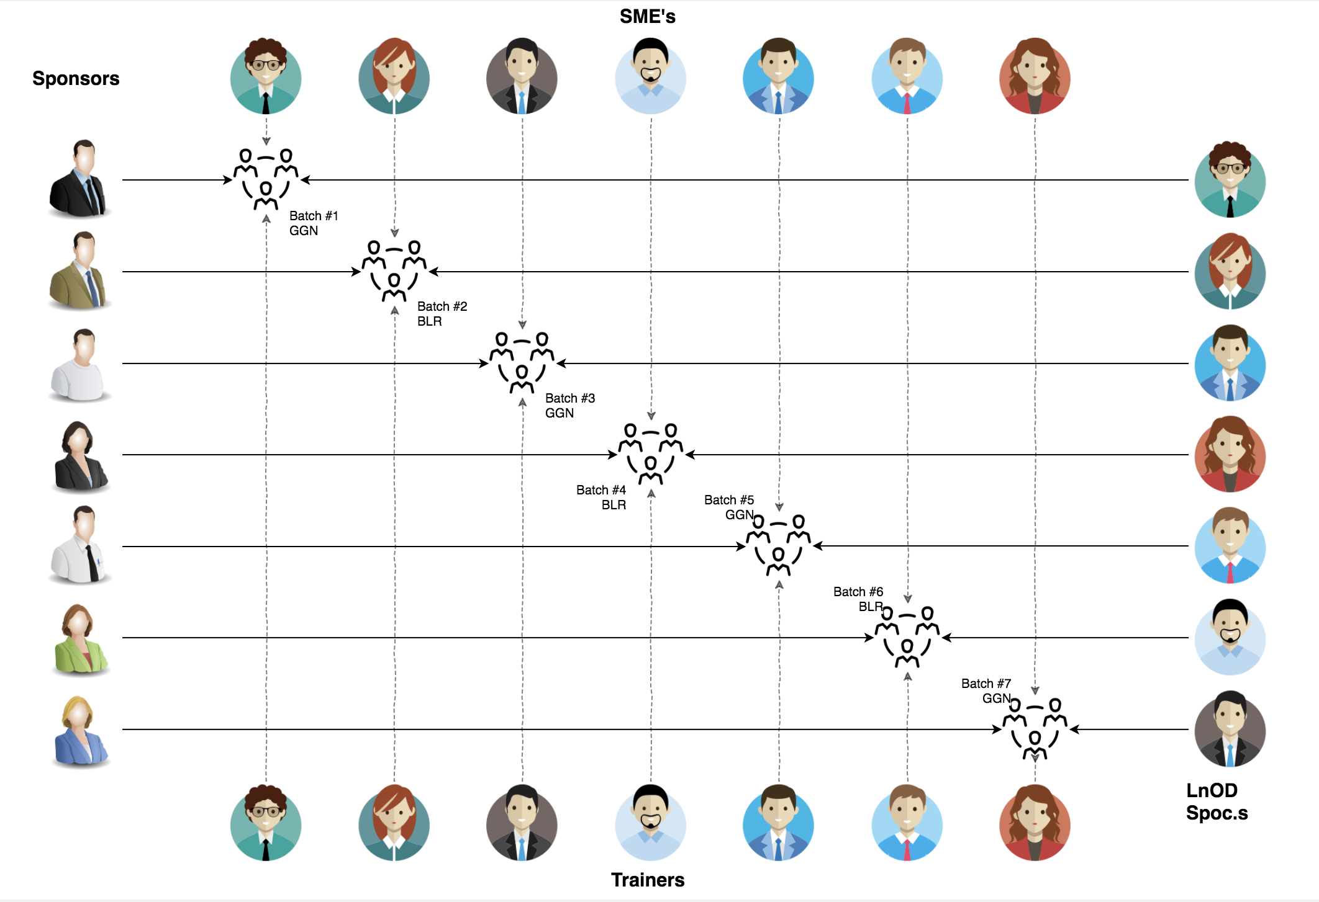
Stakeholders
Sponsors
LTI
2. Trainer
Amit Balyan

Slide 3

Agenda
01
Our Journey
02
Our Team
03
Team Structure
04
Problem Statement
05
Engineering Practices
06
Tech Stack
07
Challenges & Learnings
08
Demo
09
Questions
Notes:
Time – 1 min

Slide 4

Our Journey
Notes:
Time - 2 mins

Slide 5
ACTION PLAN
 | Modules | Description
Week 1 (Aug 08 – Aug14) | Java 11 Java OOPs UML Diagrams | Understanding Java 11 and OOPs features and collections Requirement understanding and diagram design
Week 2 (Sept 05- Sept 11) | Exception Handling SQL | Developing a POS Application using Java and MySQL. Understanding Exception Handelling
Week 3 (Sept 12- Sept 16) | GIT Spring REST Microservices | REST API Development using Spring Boot

Slide 6
Demo
Testing
Process
5
CRS Project Demo
Tools
4
Testing on Console, REST client such as Postman
Comprehend
3
Architecture Design and Development
2
Decide the Technology stack for console and REST API development
1
Understanding Project Requirements and Goals

Slide 7
Journey starts
NOW
Notes:
Time – 1 min
Swati

Slide 8
3 WEEKS OF TRAINING + PROJECT DEMO
15 DAYS
135 HOURS
8100 MINUTES
486,000 SECONDS
LIMITLESS KNOWLEDGE

Slide 9

Our Team
Notes:
Time – 2 mins

Slide 10
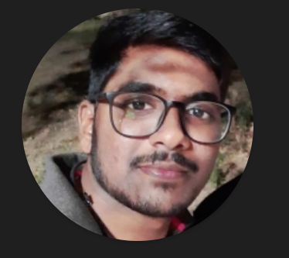
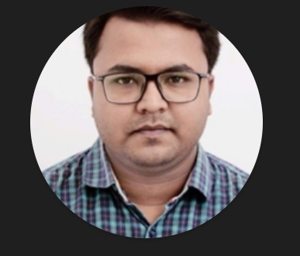
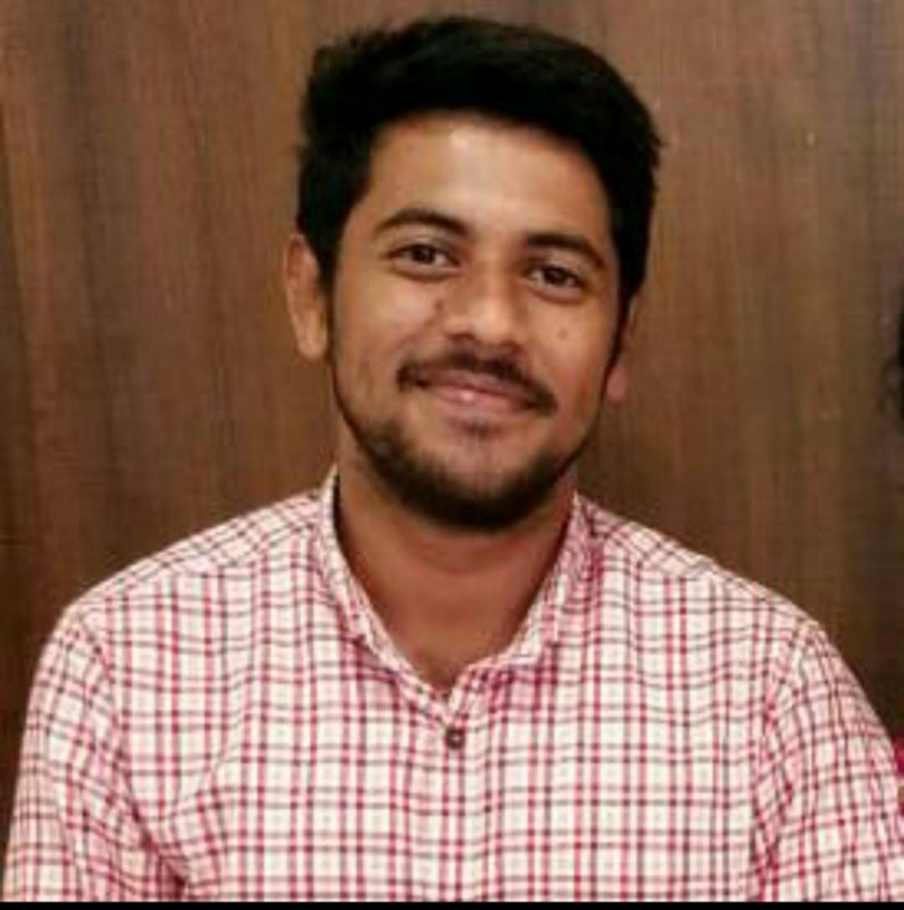
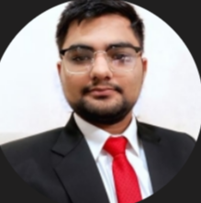
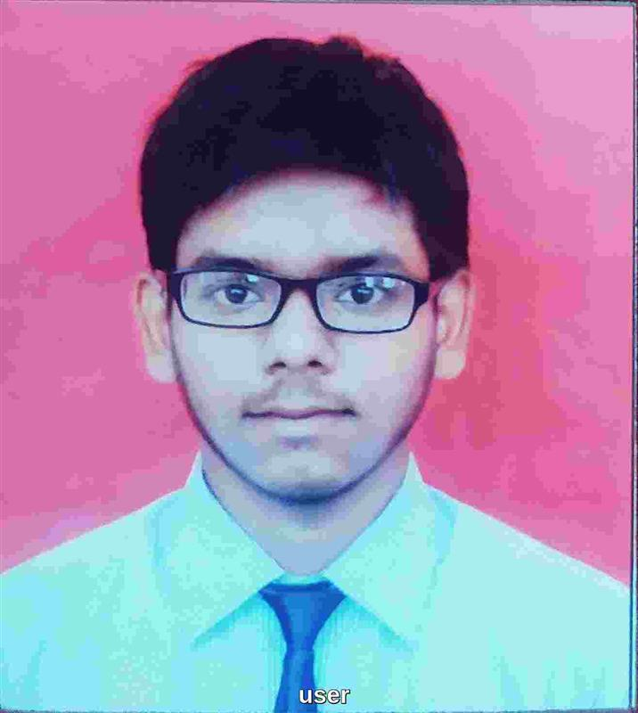
Deepankar Pradhan
Ahemad Pathan
Rajesh Reddy Gakkula
Aryan
Rushabh Patil

Slide 11

Team Structure
Notes:
Time – 2 mins

Slide 12
Name | Responsibility
Deepankar Pradhan | Implemented Professor, User functionalities
Aryan | Implemented Student, User functionalities Sequence Diagrams
Ahemad Pathan
Rushabh Patil | Implemented Admin functionalities Class Diagrams
Rajesh Reddy Gakkula
Notes:
Name alongwith responsibilities

Slide 13

Project Goals
Notes:
Time – 3 mins

Slide 14




Problem Statement
To develop a POS application and REST API for Course Registration System using JAVA where the student can register, add/drop course,view report card, do the fee payment, Professors can view courses, enrolled students, allocate grades to students while admin can manage users, add/drop courses to catalog.
1
2
Quality
Security
3
4
Interactivity
Speed
Notes:
User satisfaction and brand value
Problem Statement

Slide 15

Engineering Practices
Notes:
Time – 5 mins

Slide 16
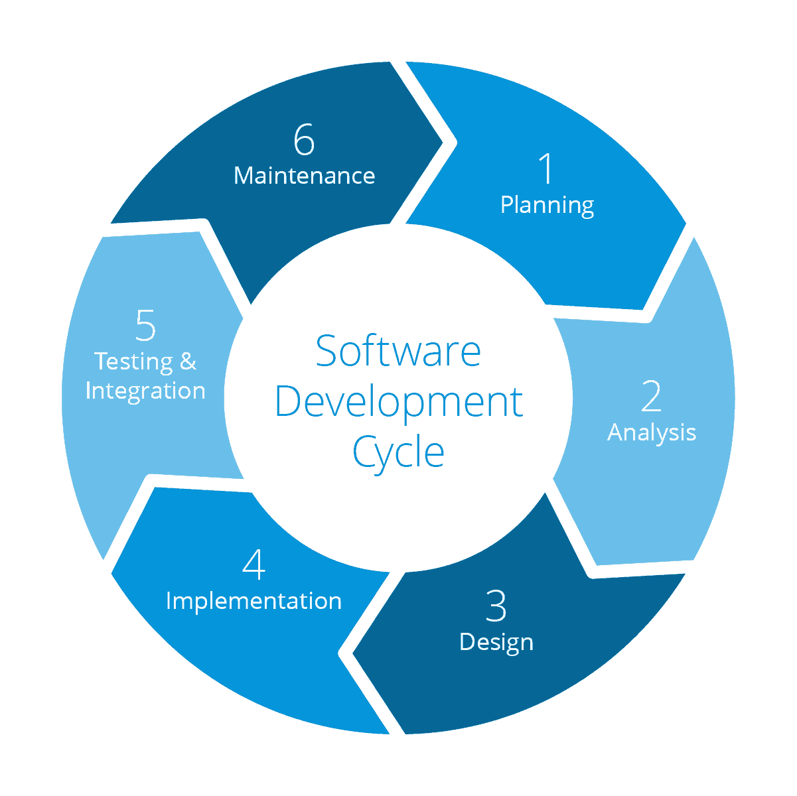
Requirement Gathering
Tech Stack Selection
UML Artifacts, Architecture Design
Code development
Notes:
Implementation ->

Slide 17

Tech Stack
Notes:
Time – 2 mins

Slide 18












Backend
Testing
Data
SCM
Core Language
Tools
SQL Database
Code Collaboration
Framework
Application Server
Notes:
Time – 1 min
Java
Maven
DropWizard
MySQL
Jersey
GitHub
Postman / ARC (Check it)
StarUML / Dia / Lucid Charts
List
Design
Backend
Testing
Tools

Slide 19

Challenges & Learnings
Notes:
Time – 2 mins

Slide 20
 | Challenges | Learning
Week 1 | Understanding the problem statement Application of OOPs concept in project Installation softwares on multiple environments | Problem Statement Learning Java 11 Java OOPs Spring STS
Week 2 | Collaboration issues such as merge conflicts in Git POS application development using layered architecture | SQL Git commands Exception Handling
Week 3 | Resolving jar and version dependencies Testing with Request Methods Running Apache TomCat server Service to API | REST API development using Spring Boot Maven POSTMAN

Slide 21

Architecture Design
Notes:
Time – 1 min

Slide 22

POS Application
Java Main Client
Business Code
Database Code
HTTP Request
HTTP Response
Notes:
n-tier

Slide 23

Demo
Notes:
Time –
Architecture – 5 mins
NFR Dashboard – 3 mins
Demo – 10 mins
1. Show the Responsiveness and Wave tool first

Slide 24

Questions
Notes:
Time - ?

Slide 25
Thank you
Notes:
Time – After this show the testimonial video. 1 min

